Slide 1
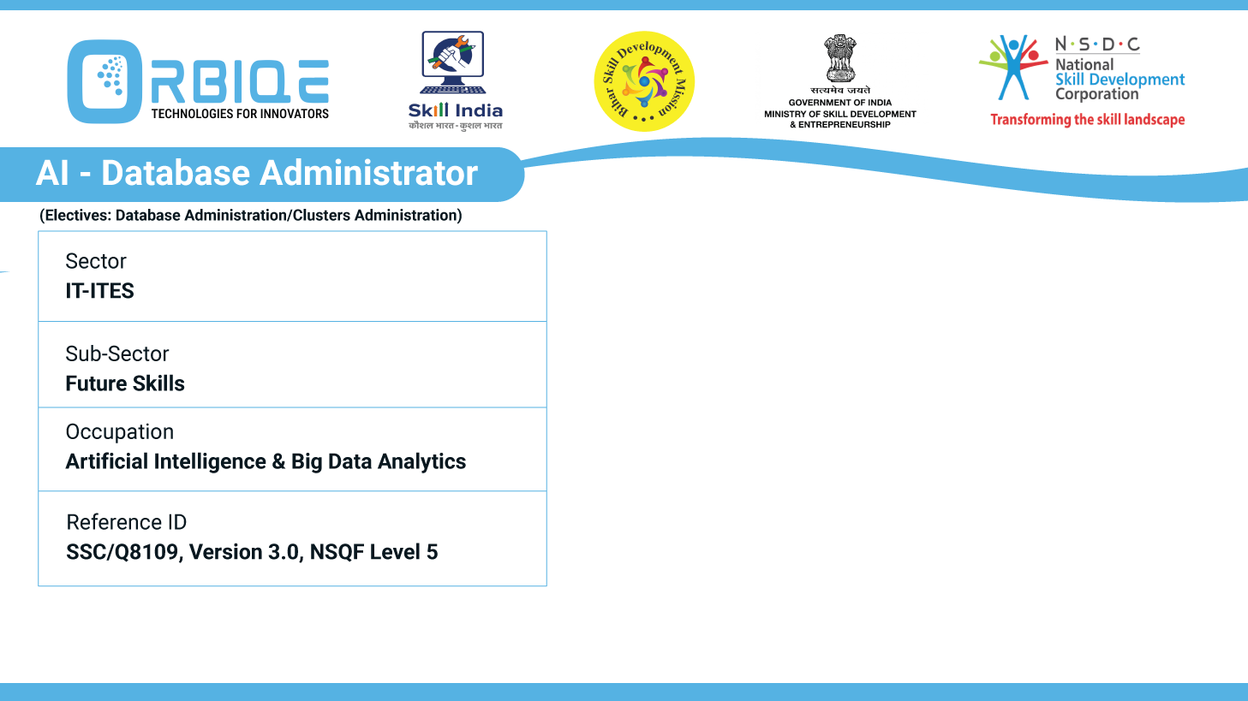
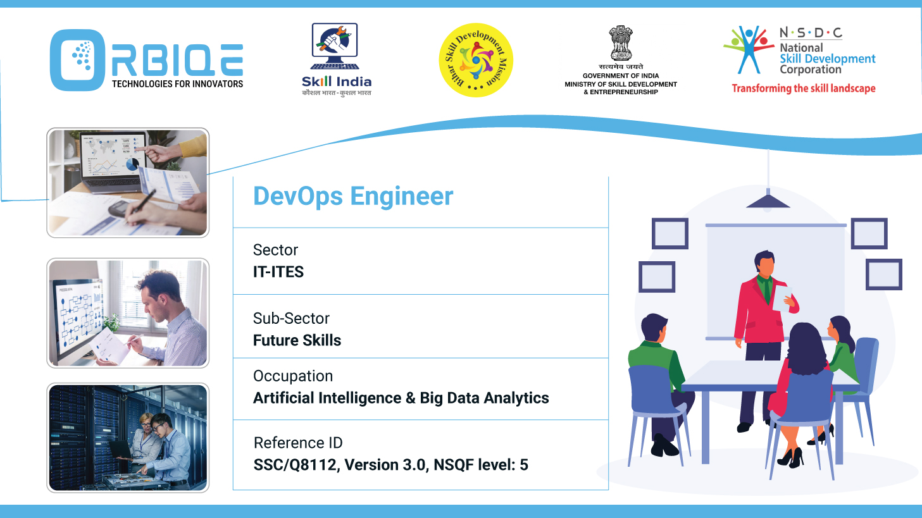
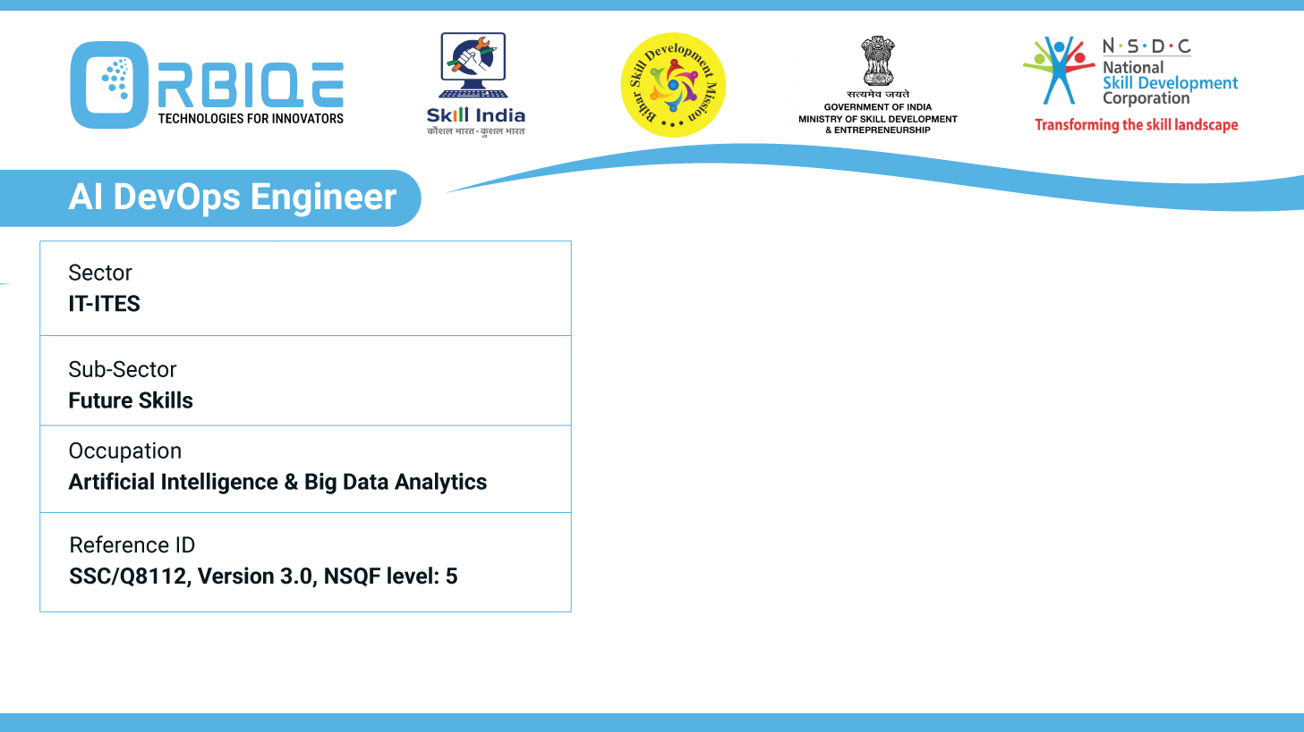
Name- Krishna Kant Dubey

Slide 2

Decoding Database Diversity: Segmentation, Schema, and Beyond

Slide 3
Agenda
Explain different databases based on data segmentation, schema, querying, storage, availability, and speed requirements, providing a comprehensive understanding of their varied characteristics

Slide 4
Tools for configuration management
Relational Databases (RDBMS)
NoSQL Databases
Key-Value Stores (e.g., Redis, DynamoDB)
Columnar Stores (e.g., Apache Cassandra, HBase)
Graph Databases (e.g., Neo4j, Amazon Neptune)
Time-Series Databases

Slide 5
Relational Databases (RDBMS)
Characteristic | Description
Data Segmentation | Timestamped entries
Schema | Optimized for time-series
Querying | Time-based filters, aggregations
Storage | Disk-based with compression
Availability | High with clustering
Speed | Extremely fast for time-based metrics and rollups

Slide 6
NoSQL Databases (Document Stores)
Characteristic | Description
Data Segmentation | Timestamped entries
Schema | Optimized for time-series
Querying | Time-based filters, aggregations
Storage | Disk-based with compression
Availability | High with clustering
Speed | Extremely fast for time-based metrics and rollups

Slide 7
NoSQL Databases (Key-Value Stores)
Characteristic | Description
Data Segmentation | Key-value pairs
Schema | Schema-less
Querying | Simple get/put operations
Storage | In-memory or disk-based
Availability | Extremely high (DynamoDB uses multi-region replication)
Speed | Ultra-fast for caching and session data

Slide 8
NoSQL Databases(Columnar Stores)
Characteristic | Description
Data Segmentation | Column families
Schema | Semi-structured
Querying | Limited joins, optimized for wide tables
Storage | Disk-based, column-oriented
Availability | High via distributed architecture
Speed | Fast for write-heavy workloads and time-series data

Slide 9
NoSQL Databases(Graph Databases)
Characteristic | Description
Data Segmentation | Nodes and edges
Schema | Flexible, relationship-focused
Querying | Graph traversal languages (Cypher, Gremlin)
Storage | Disk-based, optimized for relationships
Availability | Moderate to high depending on setup
Speed | Fast for relationship queries; slower for bulk operations

Slide 10
NoSQL Databases(Time-Series Databases)
Characteristic | Description
Data Segmentation | Timestamped entries
Schema | Optimized for time-series
Querying | Time-based filters, aggregations
Storage | Disk-based with compression
Availability | High with clustering
Speed | Extremely fast for time-based metrics and rollups

Slide 11
NoSQL Databases(Graph Databases)
Characteristic | Description
Data Segmentation | Nodes and edges
Schema | Flexible, relationship-focused
Querying | Graph traversal languages (Cypher, Gremlin)
Storage | Disk-based, optimized for relationships
Availability | Moderate to high depending on setup
Speed | Fast for relationship queries; slower for bulk operations

Slide 12
Thank You

